Slide 1
Basic presentation
Intelligence business solutions

Slide 2
1. | Introduction
2. | Base of presentation
3. | Making of Power Point material
4. | Summary and homework

Slide 3
1. | Introduction
2. | Base of presentation
 | Aim and purpose
 | Project of presentation
 | Document creation of presentation
 | Preparation for presentation
 | Execution of presentation
3. | Making of Power Point material
4. | Summary and homework

Slide 4
Importance of presentation
The thing that IBS offers doesn’t have
physical form. We can’t see it.
It is necessary to make it to visible to tell it.
Customers sympathizes with the solution
we created.
And, we should be able to promote their action.

Slide 5
Goal of presentation
Transmit what we want to tell to the other party. And, the action should be able to be promote their action.
Ideal
Actual presentation (insufficient part)
100
It is not possible
to agree.
85
It is not easy
to understand.
70
The impact
is insufficient.
55
It doesn't related
to the next action.
40

Slide 6
Aim and the purpose in this chapter. What are necessary skills?
Ability to convince, simplicity, impact, and we promote their action.
What should we do about it?
Ability to convince
Is there a persuasive key message?
Simplicity
Is the flow of the presentation that understands easily made?
Impact
Are there the impacts that leave the message for listener's mind?
Promote their action
Is it listener's feelings piled up, and we can promote their action?

Slide 7
1. | Introduction
2. | Base of presentation
 | Aim and purpose
 | Project of presentation
 | Document creation of presentation
 | Preparation for presentation
 | Execution of presentation
3. | Making of Power Point material
4. | Summary and homework

Slide 8
①The things that we should first
It thinks about "Message of the purpose, the object person, and the key" first.
The purpose of
Presentation
For listener
･Value and profit
･Needs
･Concern
･Target and goal
･Problem
To organize above things, and clarify them.
Object person
(listener)
Key
Message

Slide 9
②Organize things that we want to tell(1/2).
To organize things that we want to tell, we use the KJ method.
Four steps of KJ method
①
Write down the thing that we have thought on one card.
②
Classify cards.
③
Write the line and circle about the relations between groups.
④
The idea is structurized.

Slide 10
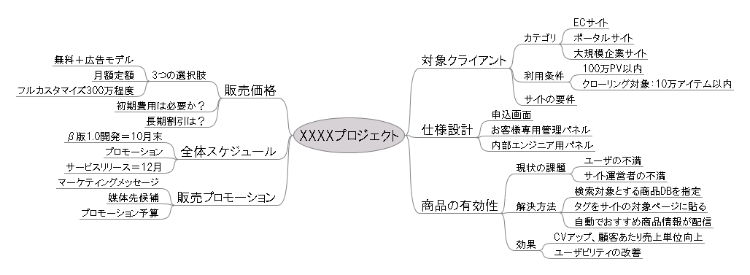
②Organize things that we want to tell(2/2).
To organize things that we want to tell, we use the mind map.

Slide 11
③ storyline
Should we use bottom-up method or top-down method?
Bottom-up
Top down
Storyline
Situation
Fact/case
We focused to xxx
at this half year.
Conclusion
The target at this half
year was achieved.
Rationale
We focused to xxx as
a target for all the
employees
Situation
Fact/case
We got xx contracts.
Conclusion
The results are xx
contracts. Therefore,
it is achievement.
Conclusion
Therefore,
it is achievement.
Usage
It is effective against the person in charge who should get to know detailed information.
It is effective agains top management people and the decision-maker, etc.

Slide 12
Project ④ logic development
There are a deductive method and an induction method.
Deductive method (syllogism)
Induction method (analysis)
Logical structure
Assumption
All humans must be died
In the future.
Conclusion ①
Socrates died.
Conclusion ②
Plateau also died.
Fact
Socrates is human.
Cause and effect
(commonness)
Relation
Both of them are humans.
Conclusion
Therefore, Socrates must
be died in the future.
Conclusion
Therefore, all humans
must be died in the future.
Explanation
Approach method of relating two information, and bring out the conclusion.
Approach method of bringing out the meaning from two or more facts.
Usage
It is effective for the persuasion and the motivation, etc.
It is effective for the persuasion, the motivation, the information transmission, and the report, etc.

Slide 13
1. | Introduction
2. | Base of presentation
 | Aim and purpose
 | Project of presentation
 | Document creation of presentation
 | Preparation for presentation
 | Execution of presentation
3. | Making of Power Point material
4. | Summary and homework

Slide 14
Making ① contents
Fix the contents idea first. It will stray if we do not do it.
The same page as contents is used
as a partition of each chapter.
The entire composition is shown in the figure
in the chart, and the corresponding section is
emphasized.
We will remind all the contents at the timing of each partitions. Because it is possible to
make the listener image the overhead view of the entire explanation, the understanding
level is improved.

Slide 15
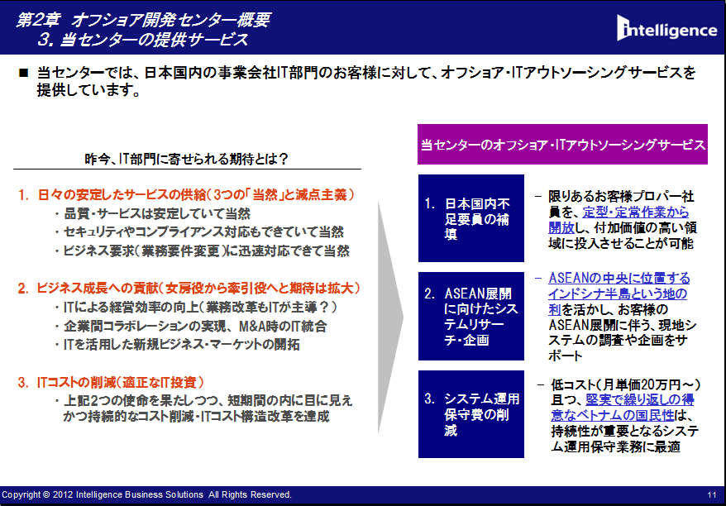
making ② structure of each slides
The element that composes the page has three things
(the title, the message, and contents).
Title
Message
Contents

Slide 16
making ③ make messages
The message of the key to be told is brought together from 1 to 2 lines.
Considered point | Point in making concretely
･It is easy to see. ･It is easy to understand. ･It remains in the impression. | ･Consistency of externals ･Union of fonts ･Large font ･Union of expressions etc.
In addition!
- When it is made simple short, the message that becomes a key is effective.
⇒When the key word is made, "In one word, what is?" is considered.
- Coexistence in the chapter of the same script is avoided.
⇒Japanese, English, substantive stop, and verb stop, etc.

Slide 17
making ④ making chart (1/7) - concept data -
Is it a concept or data that you want to express? The most effective chart is selected.
Concept chart
Data chart
Example
General chart
･Matrix chart
･Organizational chart
Table
･Classification table ･Rating form
･Spreadsheet
Chart used
In the IT industry
･Flow chart
･Image chart
･Sequence chart
･System configuration chart
Graph
･Pie chart ･Line chart
･Bar chart ･Line chart
･Scatter chart ･Bubble chart
･Radar chart
Usage
The mechanism is organized.
Complex information is organized.
It feels it by the sight.
The point of the idea is clarified.
Analysis result
Sharing of numerical value

Slide 18
making ④ making chart(2/7) – Question 1-
Express Intelligence about the state of
the business with one slide.

Slide 19
making ④ making chart(3/7)- Q1:Answer example -
We use 3C analysis. Besides, the strengths, weaknesses, opportunities and threats analysis(SWOT) is also ok.
Market circumstances
(Customer)
The market scale of the fitness club has expanded continuously after 2003. Growth rate is slowing down now.
Trend of competitor
(Competitor)
The sales share of ten major companies exceeded 50 percent.
A small club that takes the profit by the number of members after 100-300. And a large-scale total club that passes 4,000 general meeting number people when opening is existing, and the diversification of business conditions is advanced.
Your situation and how to fight
(Company)
On the side of IT to aim at 300 stores by the FC development for three years from 2008
Construction of "Mechanism that accomplishment of a goal is achieved lasting long"
"Efficiency improvement of no core business. " as possible to be concentrated on accomplishment of a goal
"System configuration that controls introduction cost" for a store
We recognize above 3 points are important.

Slide 20
making ④ making chart(4/7) – Question 2-
"Wii of NINTENDO"
VS "PlayStation of SONY".
Show the differentiation strategy
in the figure.

Slide 21
making ④ making chart(5/7)- Q2:Answer example -
We use the strategy campus of the blue ocean. We set the differentiation element as horizontal axis, value for the customers as vertical axis. So, we can understand differentiation points easily.
Good ← Value for customer → Bad
5
4
3
2
1
Fee
Equipment for service achievement
Quality of service
Traffic
Access
Gym
Studio
Pool
Bath
Feeling
of luxury
Sense of
accomplishment
Your company
Circuit form type club

Slide 22
making ④ making chart(6/7) - uniting of data and concept -
The build up water fall chart that unites data with the concept exists.
Build up chart
Water fall chart
We sometimes use this chart when we emphasize the gap between plan and current situation.
We sometimes use this chart when we analyze sales and gross profit.
Profit objective
Current sales
10
100
90
20
20
Gap
Reduction
in the cost
of materials
The cost of materials
10
10
Efficiency improvement
of line
Shipping expense
15
Current
profit
8
Reduction
in shipping
expense
Processing
expense
10
Labor cost
52
Advertising
45
Operating deficit of 13 (one million yen)

Slide 23
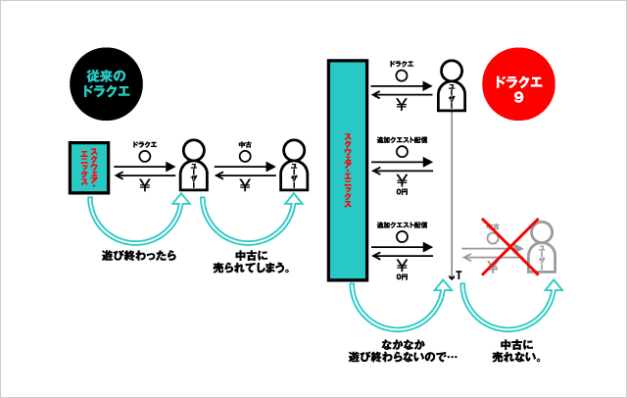
making ④ making chart(7/7) - power of expression improvement of chart -
First of all, to improve ability of expression, the study of the strategy framework and the pict illustration is recommended.
Strategy framework (http://www.strategicmanagementinsight.com/tools/vrio.html)
Value chain analysis,
SWOT analysis
Pict illustration example (http://3w1h.jp/picto)

Slide 24
1. | Introduction
2. | Base of presentation
 | Aim and purpose
 | Project of presentation
 | Document creation of presentation
 | Preparation for presentation
 | Execution of presentation
3. | Making of Power Point material
4. | Summary and homework

Slide 25
Presentation preparation
We will understand the listeners, persuade them, promote them to act.
We will prepare the presentation.
It is necessary to understand the content of the proposal well and to have the confidence.
Execute the rehearsal many times (Third party will confirm it is necessary).
･We can understand whole the structure of contents easily?
･The content of the explanation is related to the documents?
･Explanation time is appropriate?
⇒It is important to acquire the experience.
We prepare the answer against the questions.
･What kind of questions does the listener have?

Slide 26
1. | Introduction
2. | Base of presentation
 | Aim and purpose
 | Project of presentation
 | Document creation of presentation
 | Preparation for presentation
 | Execution of presentation
3. | Making of Power Point material
4. | Summary and homework

Slide 27
Execution ① opening
Suggestion of the whole image and attraction.
How to start and how to advance it
Gree-
ting
Confirmation of purpose
and precondition
Suggestion of
directionality of
presentation (conclusion)
Composition of presentation
and
Suggestion of structure
“To attract" is important.
･Word of psychologist Zunin of the United States
"Person's first impression will be decided in the first four minutes regardless of the presence of the conversation. "
It is difficult for the impression at this time to be going to give, and to overturn the preconception until the future.
The opening with the impact!!
Question
Humour
Impressive case
The author's
quotation

Slide 28
Execution ② language and non-language
Not only the language but also non-language is considered.
Speaker
1. Language
2. Non-language
Listener
Non-language | Point in execution
Expression | Be relaxes, and speak from beginning to the end in a bright expression.
Voice | Speak with intonation. Emphasize important point.
Glance and eye line | Don’t look at the slides as possible, and eye contact to the entire listener evenly. (The frequency to the key person is high. )
Gesture | Spread out the palm of your hand, raise your hand, and stretch yourself. Signal by the finger, and walk to listener (Use suitable gesture.).
Posture and attitude | Stand basically straight next to the screen, and turns ahead with relaxation. Make your backbone straight. (Posture shows the character. )
Clothes | Keep fresh and clean feeling. Pay attention to clothes, hair style, the beard, shoes, the make-up, and the fingernail, etc.

Slide 29
execution ③ Role and importance of non-language
Understand that the role that non-language part accounts for 92%. (Officer Merabian's result of the survey)
Word
What do you say?
How to talk
Condition of voice
Height
Tone etc.
Body language
Attitude
Posture
Body
Gesticulation
Face
Glance etc.

Slide 30
execution ④ bad Example of non-language
Non-language is a double-edged sword. Confirm whether the followings apply to yourself.
To say “Umm" or “Ah“ frequently.
It’s hard to hear because the ending of a word is vague.
To speak without intonation or small voice.
To speak with your hands in your pocket.
To speak with your folded arms.
To speak with your face down without seeing listener's face.
To speak without confidence.

Slide 31
execution ⑤ How to talk
Please talk effective effectively with open mind.
Effective
how to talk
Persuade the other party, and talk simply to get their consent.
Talk the desire, your insistence and idea.
Speak slowly, clearly, and greatly.
Speak by the phrase.
Speak with the concrete example.
Speak according to the listener (content, pace, and tone of voice, etc.).
How to talk
with open mind
Share atmosphere with listener and involve the other party.
Talk naturally.
Talk interactively.
Speak affirmatively.
Become modest.
Don't be fear.

Slide 32
Execution ⑥ closing
The last conclusion is important as the same as “To attract".
Summary
･Confirm the entire content, and remind the point.
･If there is a question from the listener, add the comments or explanations.
Conclusion
･Refrain the same content and the key message as the conclusion presented
by the opening.
Question
and answer
･Make positive and interactive atmosphere with the listener.
Closing
･Suggest the next step or promote the decision.
･Impress the key message and your insistence to the listener.(Be dramatic!)

Slide 33
1. | Introduction
2. | Base of presentation
3. | Making of Power Point material
 | Rule
 | NG collection
4. | Summary and homework

Slide 34
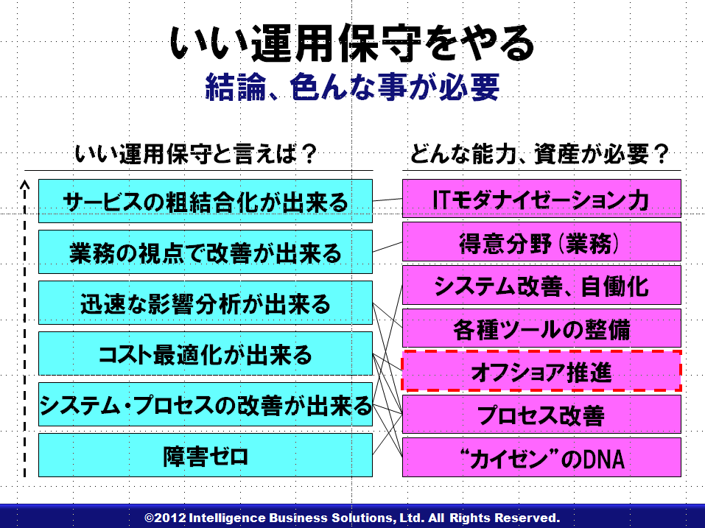
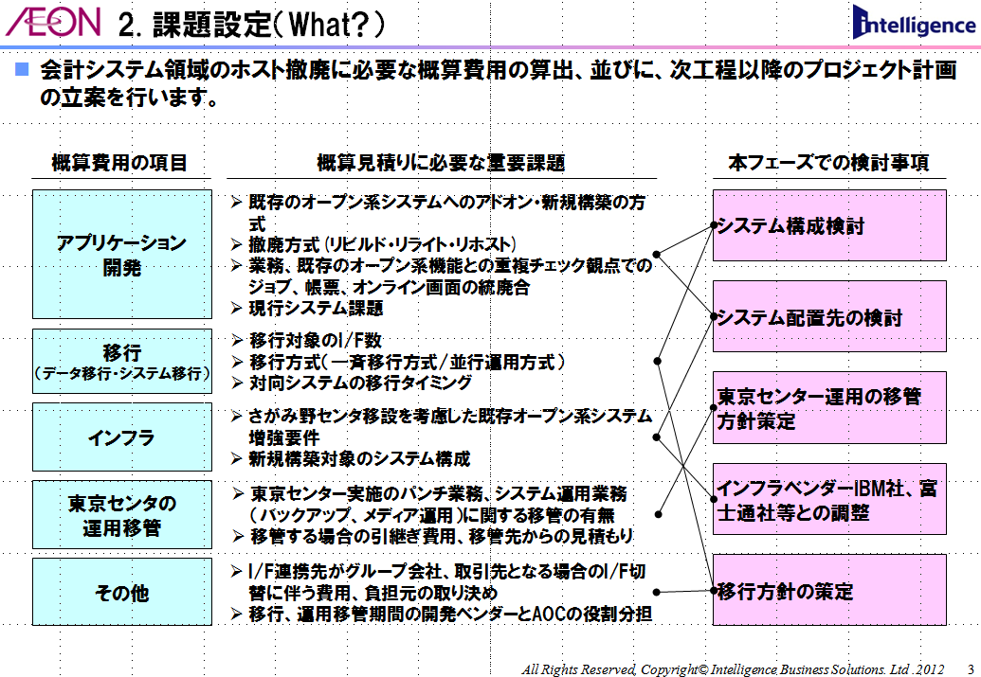
Technique ① Use slide master
Use the slide master absolutely.
Change the pattern by the usage of presentation and the proposal.
Presentation
Proposal book
The character is greatly simple in center justification.
Write intellectually.

Slide 35
Technique ② object from the left to the right and from top to the bottom
Ergonomically, we can see the upper left part at first, then the lower
left one, the upper right one, and the lower right one. (We can see it on a lot of websites.) Consider it.
Good example
Bad example
Problem
Measures
Measures
Problem
The room is dirty.
Let’s hire a
house cleaner.
Let’s hire a
house cleaner.
It is necessary
to clean it.
It is necessary
to clean it.
The room is dirty.
Even if what you are saying is the same, the feeling of agreement is greatly different
by direction of description.

Slide 36
technique ③ The adjustment of title, message, and contents.
To keep the consistency between title, message, and contents.
It’s important thing.
Good example
Bad example
Purpose
The purpose of today's conference is to fix the schedule of XXX.
Purpose
The purpose of today's conference is to fix the schedule of XXX.
XXX
Schedule fixation
Beginning time?
Participant: Mr. A, Mr. B, and Mr. C
Date: 15:00-16:00, February 11
Material: XXX.ppt
The break time?
End time?
Bad: contents of explain is different…
Make the slide as following sequence.
Title ⇒ Message ⇒ Contents
Then, review it as following sequence.
Contents ⇒ Message ⇒ Title.

Slide 37
Technique ④ contents are evenly arranged at the center.
When you arrange the contents, put it evenly at the center.
It becomes easy to understand.
Good example
Bad example
Title
Message
Title
Message
Let's do this right now, because it is easy.

Slide 38

technique ⑤ meaningful color combination
One of the big differences between the textual document and the slide such as E-mailing is color. The color stimurate right brain, and the listener can organize the content unconsciously.
Use RGB and combination of colors, complementary color simply.
The color usage : simply.
The combination of the color
is a science and a rule.
Good example
Bad example
Use the corner of RGB color with consistency.
Business A
Business B
Business A
Business B
Procedure A
Procedure B
Procedure C
Procedure D
Procedure A
Procedure B
Procedure C
Procedure D
Actually, it’s easy to understand the slides with a little color.

Slide 39
Technique ⑥ Use three magics
Express all the phenomenon by 3 things as possible.(This is the method of Steven Jobs's presentation. )
Good example
Bad example
This year's target
Company
Increase the staffs.
Improve the quality.
This year's target
In the
first half
Start English
conversation.
2.Buy the car.
3.Take a trip.
Family
1.Take a trip.
2.Buy new car.
3.Increases one's savings.
In the
latter half
Increase the staffs.
Not to catch a cold.
Improve the quality
Golf score 80
Increases one's
savings.
Myself
Start English
conversation is started.
2.Golf score 80
3.Not to catch a cold.
First understanding is more important than a correct thing.
Consider the trade-off with MECE.

Slide 40
technique ⑦ Emphasize things you want to tell in blue(or red)
When there are many sentences, emphasize the things you want to tell in blue(or red).
Usage example
What is the management (By P. Drucker)?
The organization contributes to the society through the result. It is not worthy but is ..the result.. worthy. exist organize The organization is not "Purpose" and "Means. " Management is an organization to make the organization achieve the result.
The organization achieves the result by some "Contribution to society", and the society gives organize "Freedom and dignity". Or, I cannot help admitting freedom. As a result, the organization defends the individual who belongs from totalitarianism organizing and there.
The individual self-actualizes through the organization, and the organization contributes to the society. The society gives organize freedom and dignity, and the organization gives the individual the chance of the role in money that becomes original of life, a social position, and the society, opportunities for self-realization, and the contribution to society.
The word and the short sentence make the character blue, and the long sentence
encloses the character with blue.

Slide 41
Technique ⑧ slide is not made from the white paper.
Don’t make the slides from scratch.
Use the slides that looked alike in the past. The idea more than past arises when thinking there again.
Good example
Bad example
XXX
XXX
XXXXXXXX
･XXXXX
･XXXXXX
･XXXXXX
XXXXXX
･XXXXX
･XXXXXX
XXX
XXX
XXX
XXX
XXX
XXX
XXX
First of all, only the frame is prepared, and it buries in that.
The text is arranged like mail without thinking about the frame.
It is important to collect slides that can be recycled always.
It is also important to ask others, "Does it have such a slide?".

Slide 42
1. | Introduction
2. | Base of presentation
3. | Making of Power Point material
 | Rule
 | NG collection
4. | Summary and homework

Slide 43
System improvement - Kon's system improvement matter progress report soon -
Before
I will report on the progress of the matter that will be executed by Kon soon as follows as the system improvement.
･The present provinces for the slip repetition are being released.
･The influence of accounting period 2013/02 for the rebate distribution representative is being investigated.
･Final approval waiting of specification for abnormal number of TLOG guests
Why is it double byte?
System | Operation business | Progress report | Approach in the future
Sales total | For credit details slip repetition | ･Design, development, and test (completion) ･Release is scheduled to 2012/10/12. | The duplicate data will be generated one month after it releases it or it observes it.
Rebate | For rebate distribution representative | The thing that systematization is not in time is assumed, and the influence of accounting period 2013/02 of the union correspondence of fiscal year is being investigated. | ･The further investigation and the analysis result of the cause where the distribution representative is generated are brought together, the measure that decreases the hand operation and the person work by both the use section and AOC is continued, and the improvement is executed. ･The risk by the hand operation remains. It straightens, and after systematization is examined based on distribution representative's analysis result, it proposes systematizing to ion retail Management Control Division.
TLOG | For number of TLOG:FOSS guests difference | Please refer since it the next pages.
Don’t adjust indent or spaces.
Use TAB key.
Emphasize the numeric result.
Because the contents must be explained.
- Please drink and refer to "System improvement matter list" of the reference as a system improvement for details of [ue] record matter and other matter.

Slide 44
System improvement - Kon's system improvement matter progress report soon -
Before
I will report on the progress of three matters that will be executed by Kon soon as follows as the system improvement.
For slip repetition :It is releasing it now.
For rebate distribution representative :The influence of accounting period 2013/02 is being investigated.
For abnormal number of TLOG guests :Final approval waiting of specification
Is this an important message?
It is not a message.
System | Operation business | Progress report | Approach in the future
Sales total | For credit details slip repetition | ･Design, development, and test (completion) ･Release is scheduled to 2012/10/12. | The duplicate data will be generated one month after it releases it or it observes it.
Rebate | For rebate distribution representative | The thing that systematization is not in time is assumed, and the influence of accounting period 2013/02 of the union correspondence of fiscal year is being investigated. | ･The further investigation and the analysis result of the cause where the distribution representative is generated are brought together, the measure that decreases the hand operation and the person work by both the use section and AOC is continued, and the improvement is executed. ･The risk by the hand operation remains. It straightens, and after systematization is examined based on distribution representative's analysis result, it proposes systematizing to ion retail Management Control Division.
TLOG | For number of TLOG:FOSS guests difference | Please refer since it the next pages.
The things that we should tell is not clear.
Is it overview or detailed information?
If it’s overview, we shouldn’t omit it.
Don’t use "･”. itemizes it.
- Please drink and refer to "System improvement matter list" of the reference as a system improvement for details of [ue] record matter and other matter.

Slide 45
①Results topics - preferential treatment repayment processing result -
After
The period of the 54th time of owners preferential treatment repayment processing comes. It aims at a free trouble, and it progresses while executing the verification work including three points hereafter without trouble.
"It is a number of stockholders of possession by 100 stocks or more managed by the stockholder master" and "Number of stockholders of the preferential treatment repayment object this time" must be corresponding.
The amount of the repayment must be calculated correctly at the repayment rate corresponding to the amount of purchase.
Do not result compared with the result of repayment processing last time before last ..the peculiarity...
Item and detailed explanation that was not able to be observed
Comparison between processing result and last time the time before last
Date | Work
08/29 | The schedule of the half this period processing is shared with stocks G and AOC.
09/13～ | Prior operation (address correction and complaint processing correspondence, etc.)
09/20 | Prior check before it processes it at half year
09/26 | Real thing of processing of half year (repayment details list making and CMT making)
09/29 | It ..CMT.. cooperates to the [**ei] print.
10/12 | The 54th owners repayment substitution certificate DM sending out
Item | The 52nd | The 53rd | The 54th (this time) | The last ratio
Number of stockholders | 218,477 people | 235,278 people | 245,346 people | 1.043
Amount of total purchase | 33,554,203,888 yen | 36,979,568,697 yen | 38,304,894,754 yen | 1.036
Amount of total repayment | 1,236,359,881 yen | 1,364,007,895 yen | 1,405,677,868 yen | 1.031
Number of total details | 14,445,925 | 15,460,837 | 16 million 683 thousand | 1.079

Slide 46
Before①
① Report of the last point and problem this time
(a)Visible making system
(b)Offshore
(c)System improvement report
② Report concerning AOC management
(a)Status report of matter
(b)Maintenance management operation results
③ Discussion visit matter

Slide 47
Before②
① Report of the last point and problem this time
(a)Visible making system
(b)Offshore
(c)System improvement report
② Report concerning AOC management
(a)Status report of matter
(b)Maintenance management operation results
③ Discussion visit matter
The color is different.
If the color used is decided, it is not generated.

Slide 48
1. | Introduction
2. | Base of presentation
3. | Making of Power Point material
4. | Summary and homework
 | Review
 | Homework
 | At the end

Slide 49
Review ①
What kind of techniques to organize things
we want to tell are there existing?
KJ method, mindmap, storyline(bottom-up, top-down), Deductive method (syllogism),Induction method (analysis)

Slide 50
Review ②
In presentation,
What makes the strongest impression
that accounts for 92%?
Non-verbal

Slide 51
Review ③
What are the non-verbal communications?
Please give me examples.
Attitude, posture, gesture, face, look

Slide 52
Review ④
There are two kinds of charts. What is it?
Concept and data

Slide 53
Review ⑤
What are the three components of slides?
Title, message, contents

Slide 54
Review ⑥
What do you do first,
when you make the material of slides?
Use slide master

Slide 55
1. | Introduction
2. | Base of presentation
3. | Making of Power Point material
4. | Summary and homework
 | Review
 | Homework
 | At the end

Slide 56
Homework
Make one slide about analysis of
your current situation and your future.
Please submit it to Furuki within 7 days.

Slide 57
1. | Introduction
2. | Base of presentation
3. | Making of Power Point material
4. | Summary and homework
 | Review
 | Homework
 | At the end

Slide 58
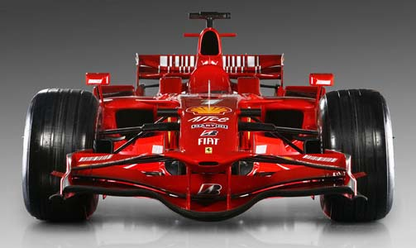
A fast car is beautiful.

Slide 59

Beautiful shape is structurally steady.
It is necessary to learn the structure
from nature.
Sagrada Familia
Architect:Antoni Gaudi

